Slide 1

ClauseGuard
Updates
SHUBHAM(A00047193)
SIDDHARTH(A00047237)
PRASAD(A00047190)
JUDE (A00046791)
KARTHIK (A00046404)
A platform that helps tenants manage tenancy records and follow Irish rental rules, keeping everyone on the same page.

Slide 2
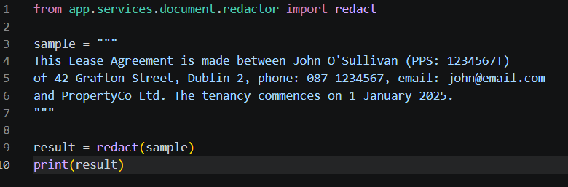

CORE ENGINE
  For the core engine, the focus was on the PII Sanitization layer. The redactor.py implemented is a middleware that combines Irish-specific Regex for PPS and phone numbers, and spaCy NER for names and addresses. This cleans the data before it is passed on to the diff_engine and model, giving absolute privacy.
  Also to enforce the privacy, the Ephemeral S3 storage was looked into. After the redactor sanitizes the text, the original unredacted text is immediately overwritten by the code. The raw PII is destroyed, and cannot be retrieved.

Slide 3
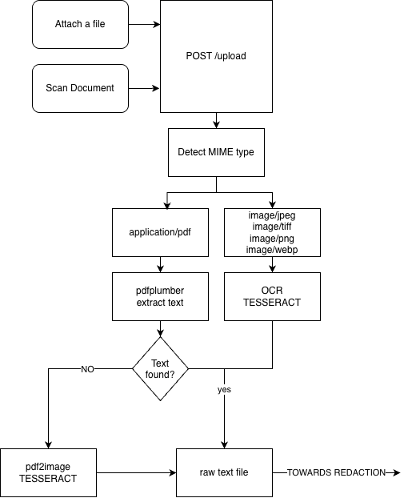
ClauseGuard
Backend Engineer
OCR and extraction
  Image uploads (JPEG, PNG, TIFF, WebP, BMP) are read with pytesseract and Pillow.
  Scanned PDFs fall back to per-page Tesseract OCR through pdf2image and Poppler when pdfplumber finds no text.
  A single extractor service detects the MIME type and routes the file to text extraction or OCR.
Processing pipeline
  Flow: Extraction → Redaction → S3 Upload.
  Errors are tracked per step (extraction, redaction, upload).
  Privacy-first design: original files are processed in memory and never stored. Only redacted text goes to S3.
Database and APIs
  A Document model tracks status (PROCESSING, COMPLETED, FAILED), metadata, a SHA-256 hash, and soft delete.
  An Alembic migration was created and applied.
  Endpoints: POST /documents/upload, GET /documents/, GET /documents/{id}, DELETE /documents/{id}.
  All endpoints are documented in API_DOCUMENTATION.md.

Slide 4
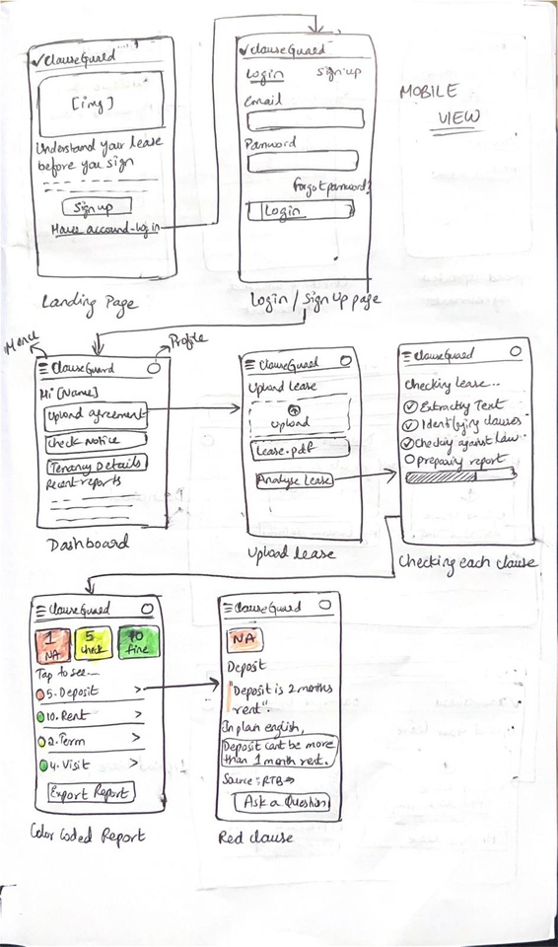
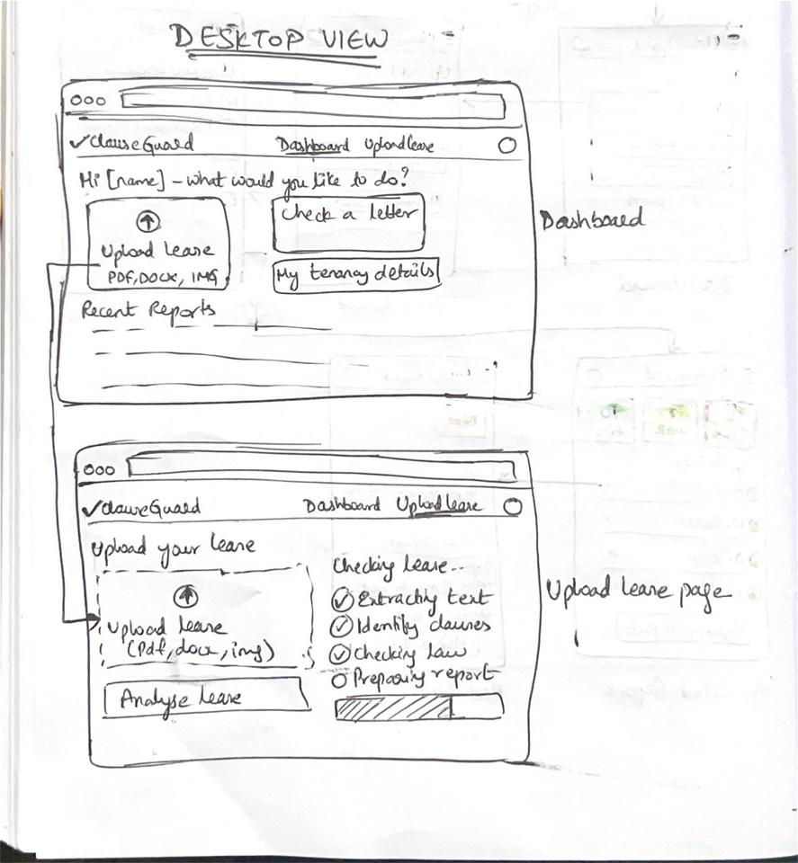
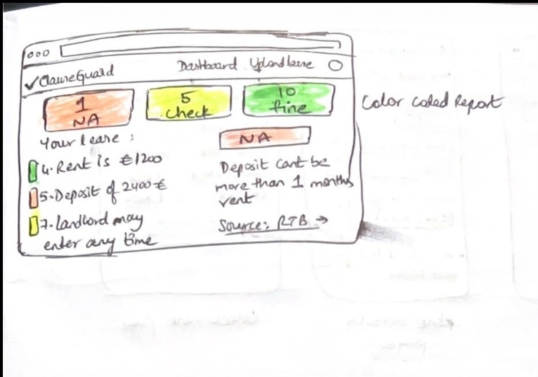

ClauseGuard
Low Fidelity Prototype

Slide 5
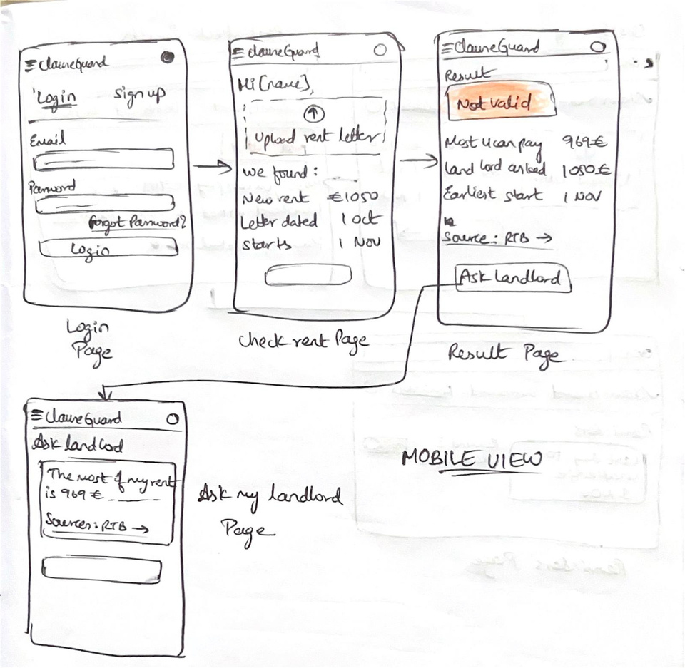
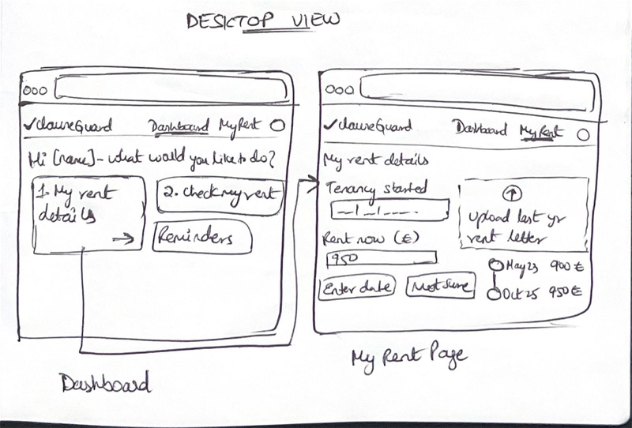
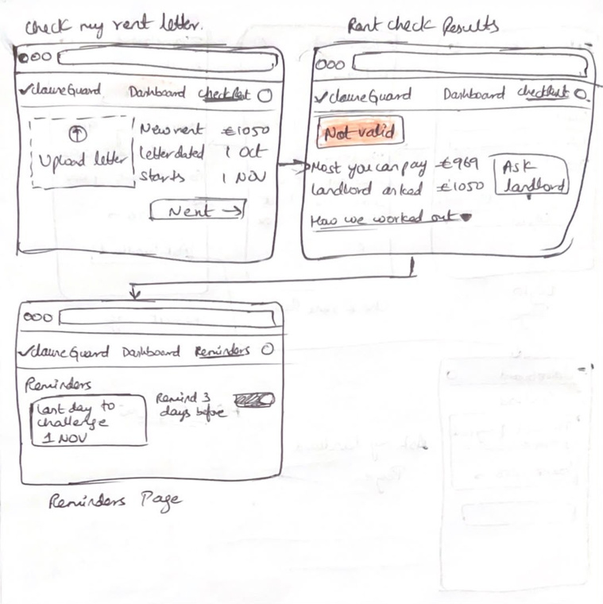
ClauseGuard
Low Fidelity Prototype

Slide 6






Wireframes
ClauseGuard
  Landing Screen
  Login Screen
  Dashboard
  Upload Lease
  Analysing Lease
  Lease Review

Slide 7
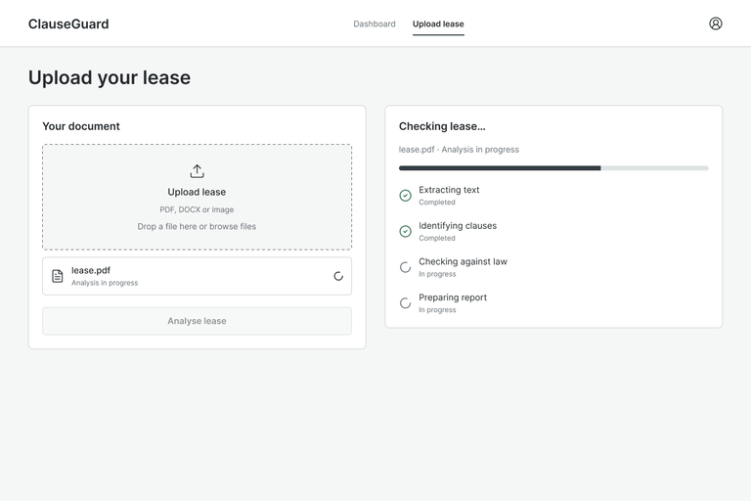
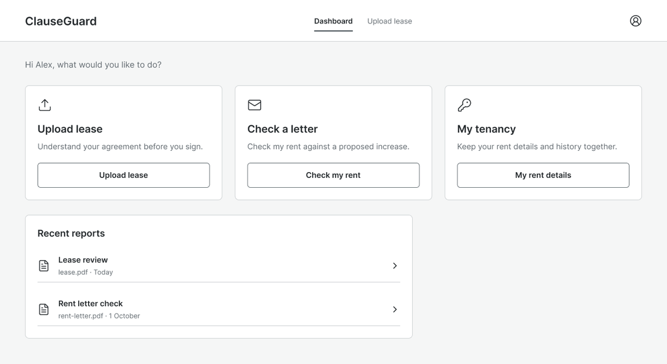
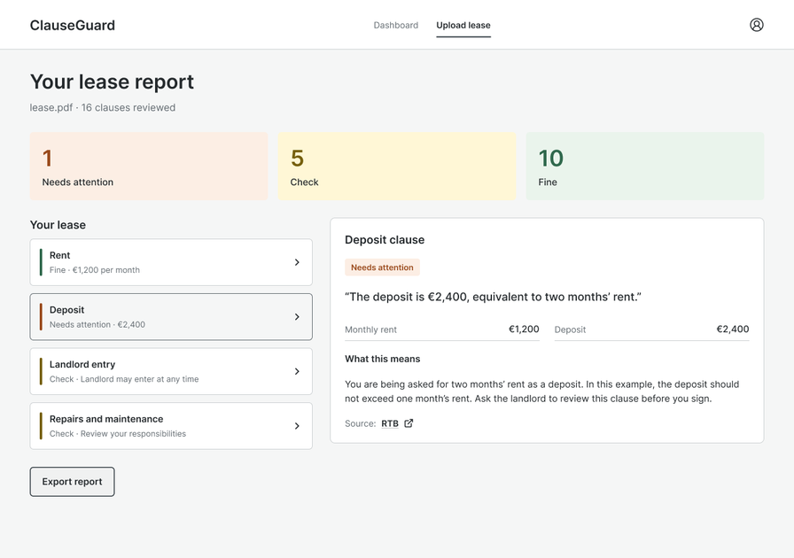
ClauseGuard
Medium Fidelity Prototype
Upload Lease

Slide 8
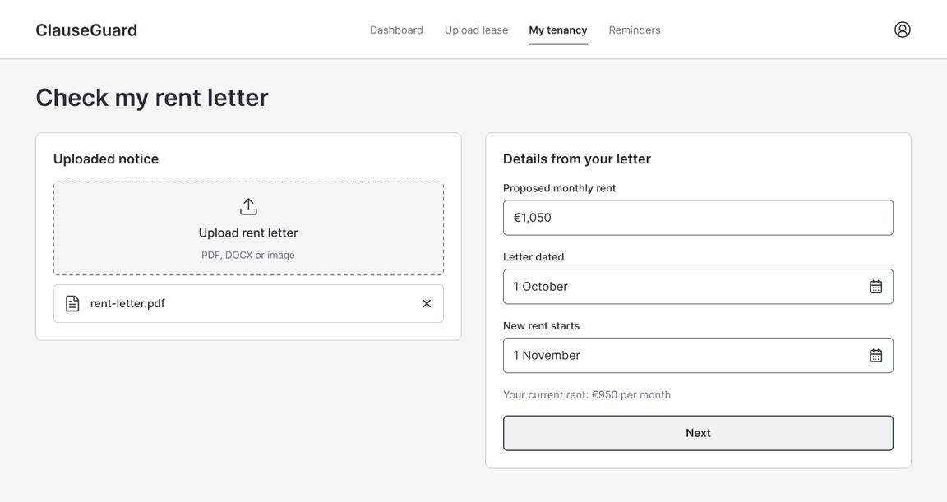
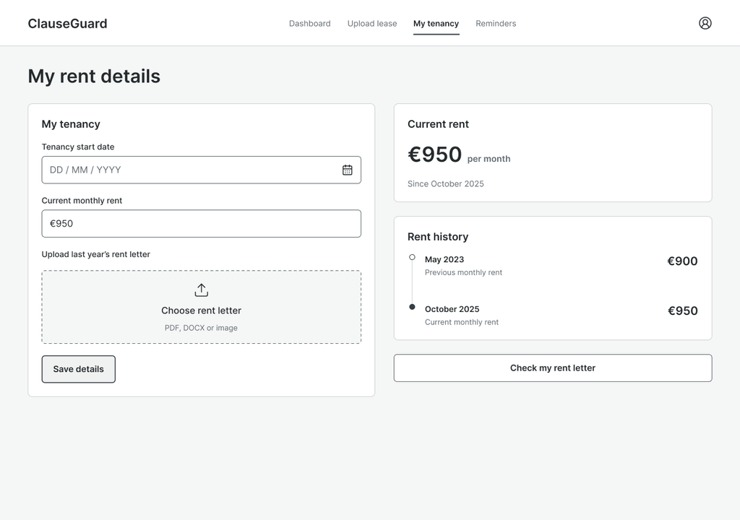
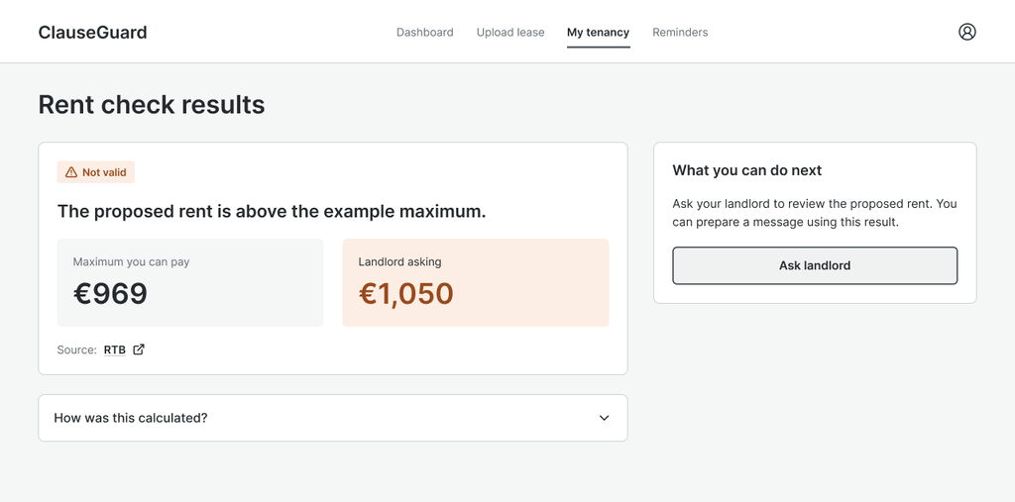
ClauseGuard
Medium Fidelity Prototype
Check Rent

Slide 9
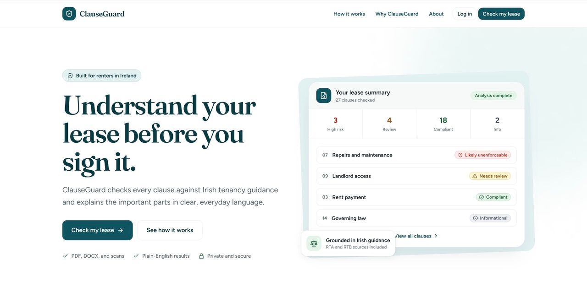
Sample Mockups - FigmaAI
ClauseGuard
Landing Page

Slide 10
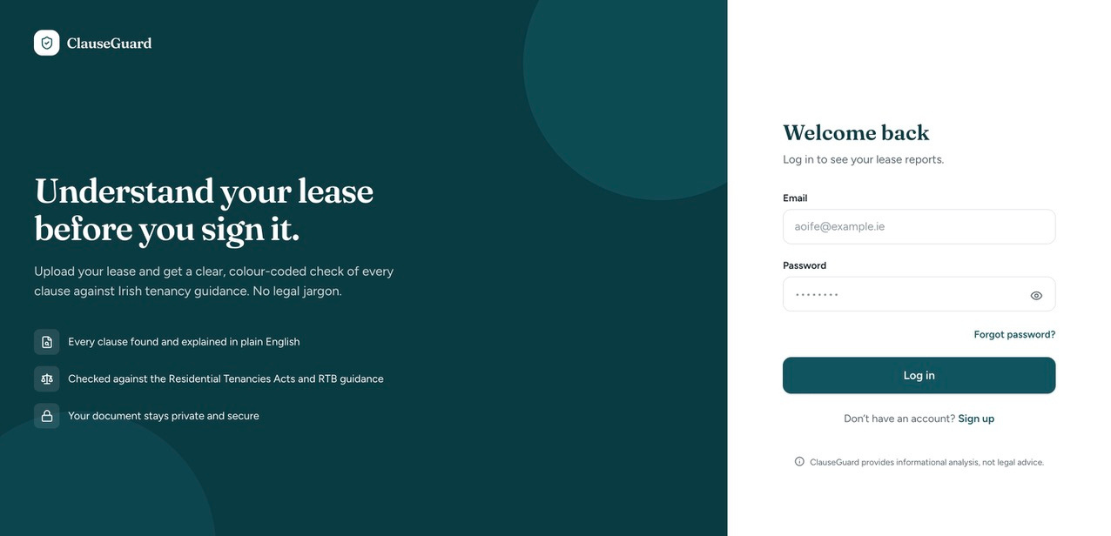
Sample Mockups - FigmaAI
ClauseGuard
How the website might look...
Login Screen

Slide 11
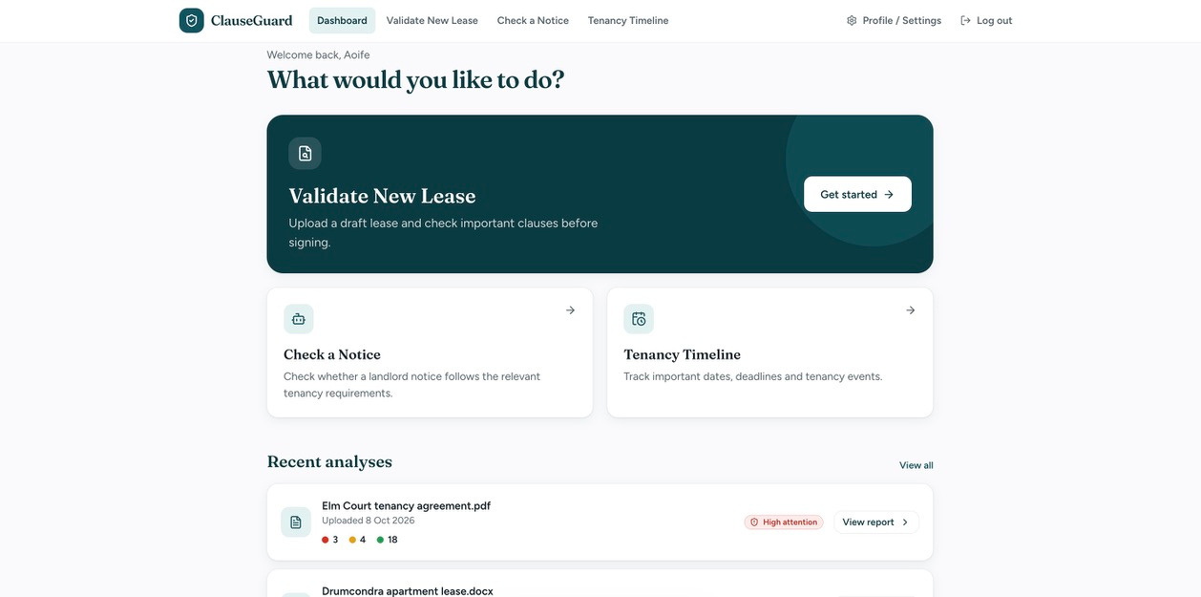
Sample Mockups - FigmaAI
ClauseGuard
Dashboard

Slide 12
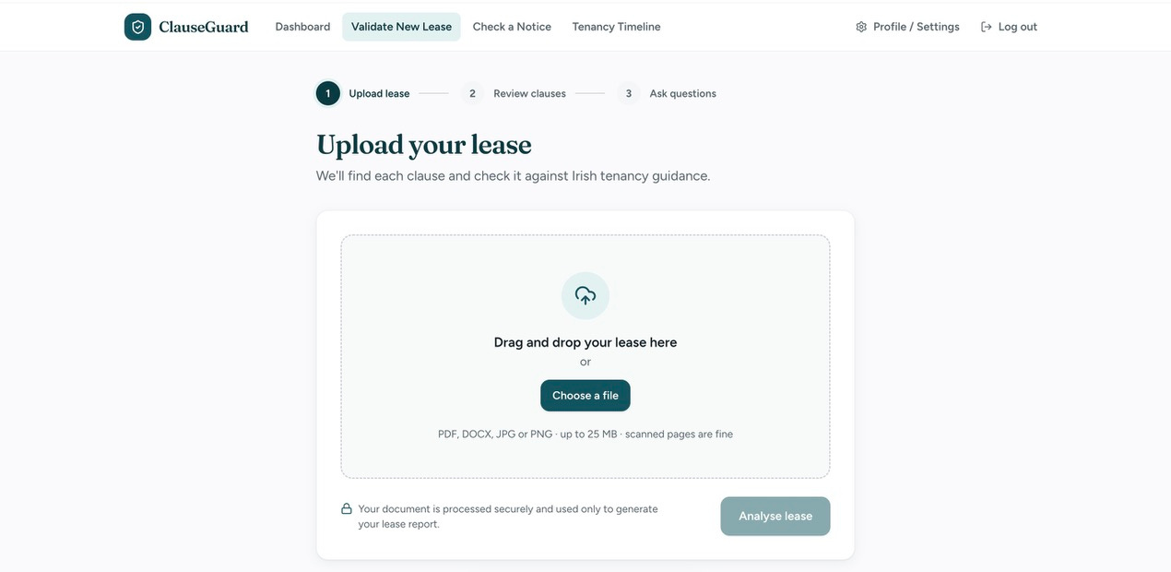
Sample Mockups - FigmaAI
ClauseGuard
Upload Lease

Slide 13
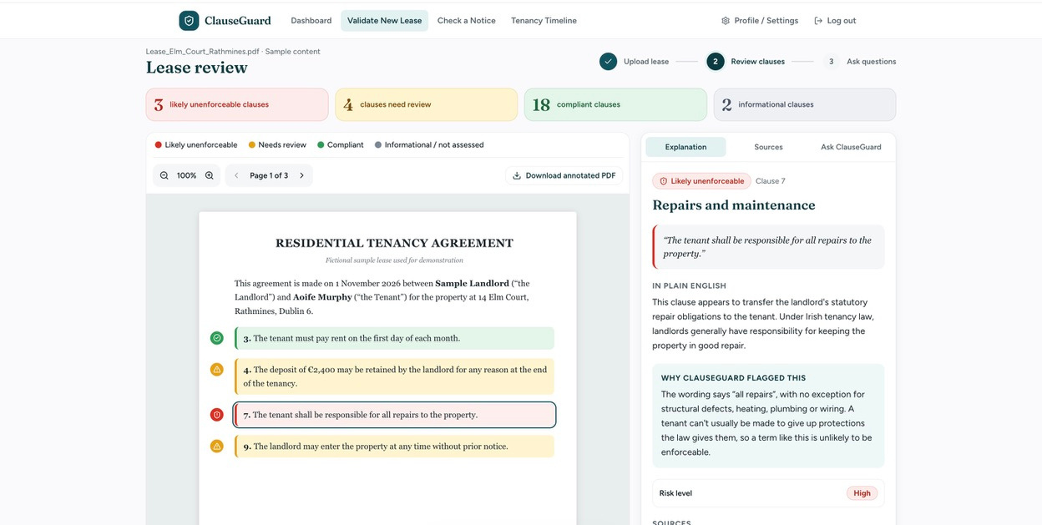
Sample Mockups - FigmaAI
ClauseGuard
Lease Review Page

Slide 14
More data, and a fairer test
A second model, comparison on actual lease
1. A second model
2. A fairer test
3. A second lease
Trained on 500 Irish Acts, the Residential Tenancies Act 2004 and a 10,000-clause LEDGAR sample
Legal-BERT and two Irish LegalBERT models, the same hidden words, 10 random masks, two leases
A real student contract with names and addresses removed
100 of 120 clauses kept, and a privacy check found nothing left
Perplexity 2.38 → 1.91 on a new held-out set.
Accuracy 59–62%.
Result: extra law and contract text did not help on lease wording

Slide 15
Labelling, and classifier test
Clauses from two leases labelled by topic, models trained on one lease and tested on the other
What we built
Model comparison
A cleaner clause splitter: 120 → 110 clauses on lease 2
Accuracy: models 0.731–0.759, always “other” 0.741 and 0.765
A split by lease, so one lease is never in both training and test
BERT, Legal-BERT and Irish LegalBERT: no major winner
A labelling tool and 152 labelled clauses
A keyword baseline: 68%, against 74% for always “other”

Slide 16
What is Next
The limit is labelled data, not the model
What it means
Then: the law
Training on Irish law helped on Irish Acts, but not on lease wording or clause classification. With about 150 labels, the models cannot be told apart
Find the right Act for each clause, check citations, and send unsure cases to “needs review”
Open items for the team: a second annotator, more template leases, GPU access, ethics approval for real leases

Slide 17


THANK YOU

